Slide 1
Non graphical Univariate analysis
This preliminary data analysis step focuses on four points, i.e. for mechanisms that you will want to examine. These include: measures of central tendency, i.e. the mean, the media and mode, measures of spread, i.e. variability, variants and standard deviation, the shape of the distribution, and the existence of outliers.
Outliers were detected and treated using the Inter Quartile range of each features

Slide 2
Non graphical Univariate analysis contd
It can be observed that average duration users spent per session is about 83s, the values ranges from 149.748s to as low as 22.33 s
The average user spends about 474.52 MB data
Most of the data spent was on Gaming

Slide 3
Non graphical Univariate analysis contd
Measure | Dur. (s) | Total data (MBytes) | Total Google data (MBytes) | Total Social Media data (MBytes) | Total Email data (MBytes) | Total Youtube data (MBytes) | Total Netflix data (MBytes) | Total Gaming data (MBytes) | Total Other data (MBytes)
mean | 83.13848 | 474.5219 | 7.441799 | 1.744182 | 2.151528 | 21.58043 | 21.58435 | 412.1221 | 409.3537
min | 22.33 | 29.65293 | 0.051401 | 0.001491 | 0.020191 | 0.075248 | 0.093872 | 0.780932 | 0.867578
25% | 86.169 | 377.3234 | 6.121752 | 1.333488 | 1.738368 | 18.79974 | 18.83158 | 315.5267 | 311.0325
50% | 86.399 | 475.1882 | 7.454777 | 1.740233 | 2.151704 | 21.56043 | 21.59459 | 412.8209 | 409.8029
75% | 86.399 | 572.7384 | 8.764079 | 2.158618 | 2.568119 | 24.34952 | 24.37053 | 510.6865 | 505.6405
max | 149.748 | 908.5096 | 14.79847 | 3.481732 | 4.304484 | 43.0664 | 43.02059 | 819.3996 | 819.2574
Table 1: Univariate description of the dataset

Slide 4
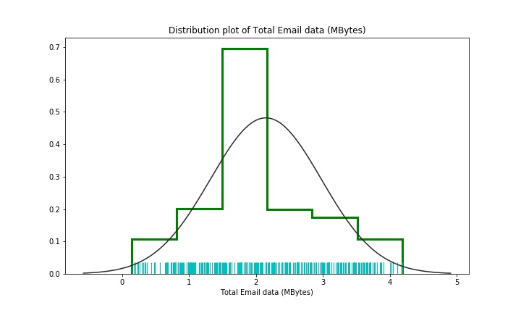
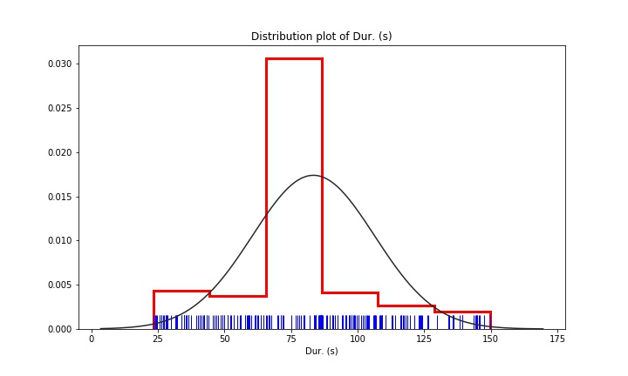
Graphical Univariate Analysis
These analysis involves the graphical presentation of the distribution of each features in the dataset
Figure 1 shows the distribution plot the Total duration of session, the mean and the percentiles are clustered around a point
Figure 2 shows the distribution plot of the Total Email data, the distribution has more data greater than the mean
Figure1: Distribution plot of total duration(s)
Figure1: Distribution plot of total email data (MB)

Slide 5
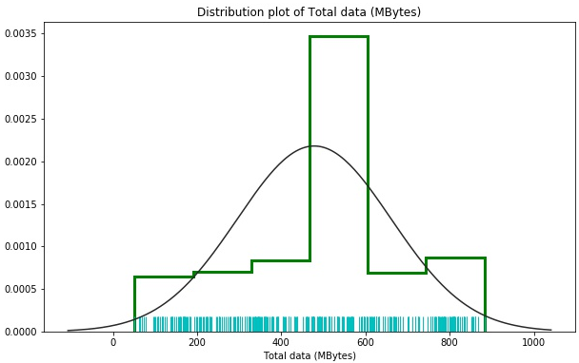
Graphical Univariate Analysis cont.
The plot is not normally distributed, the plot shows a wide spread amount of data usage over similar ranges
Figure 3: Distribution plot of the Total Data usage
The plot is not normally distributed, the plot shows that, it has wide spread.
Figure 3: Distribution plot of the Total Email data usage

Slide 6
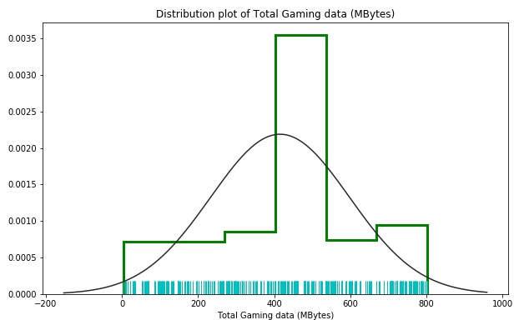
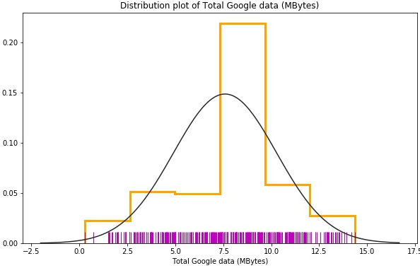
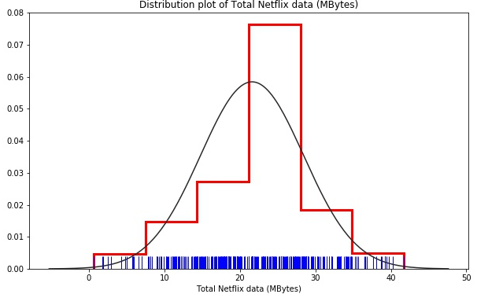
Graphical Univariate Analysis cont.
Figure 5:Distribution plot of the Total Gaming Data usage
Figure 6:Distribution plot of the Total Google Data usage
The plot shows deviation from the normal fitted curve, it shows a spread away from the mean towards left
The above plot shows deviation from the normal fitted curve, it shows a spread around a data point that is skewed to the left
The plot shows deviation from the normal fitted curve, it shows there are more data less than the mean
Figure 7:Distribution plot of the Total Netflix Data usage

Slide 7
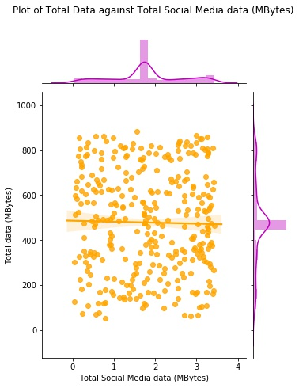
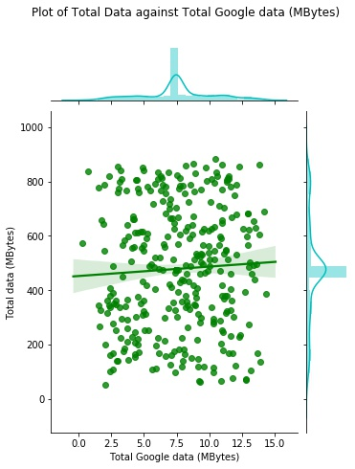
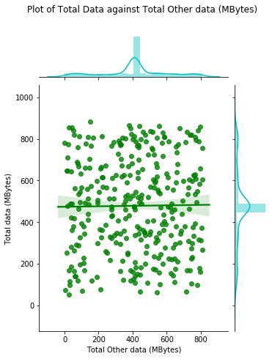
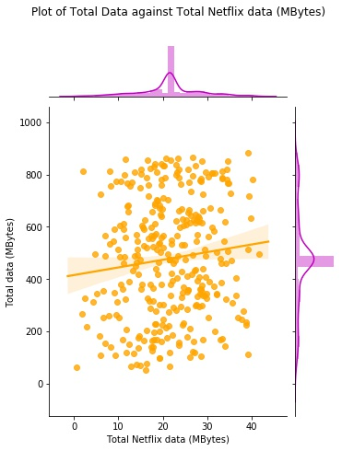
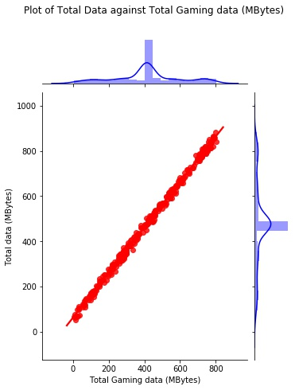
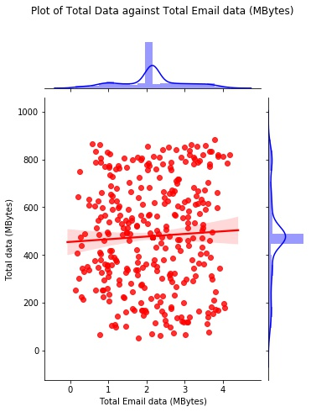
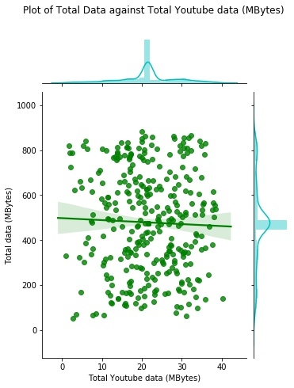
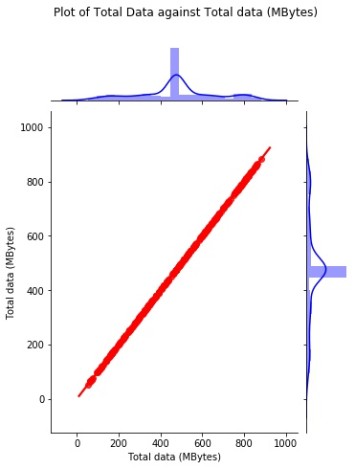
Graphical Bivariate Analysis

